Slide 1

Heredity and Evolution
Evidences For Darwin's Theory Of Evolution - 1

Slide 2


Based on these studies, can we workout the evolutionary relationships of the species around us

Slide 3
Lets understand this by going backwards in time and by identifying the similar characteristics between species

Slide 4
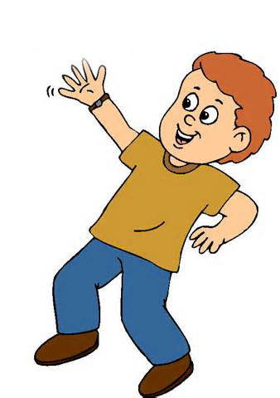
What is meant by characteristics???
Characteristics are details of appearance or behavior in other words, a
particular form or a particular function.
For example
Four limbs is a characteristic.

Slide 5

What is meant by characteristics???
Characteristics are details of appearance or behavior in other words, a
particular form or a particular function.
For example
Plants can do photosynthesis is also a characteristic.

Slide 6

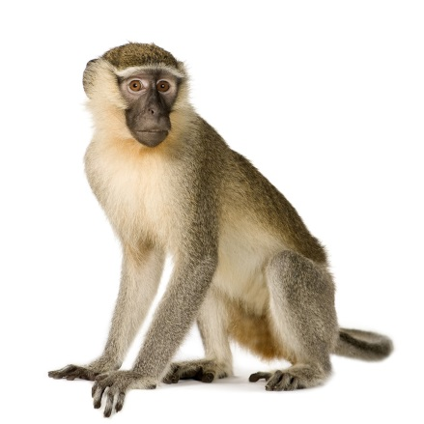
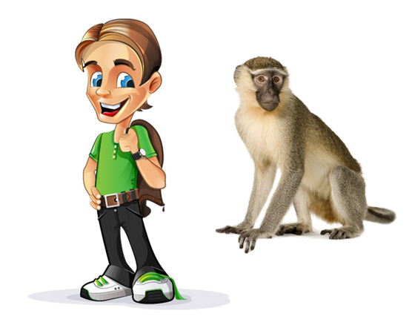
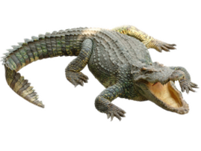
What is meant by characteristics???
Some basic characteristics will be shared by most organisms.
All have common four limbs.
The more characteristics two species will have in common, the more closely they are related.
The more closely they are related, the more recently they will have had a common ancestor.

Slide 7
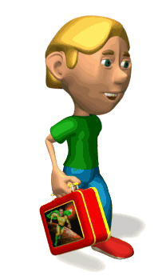

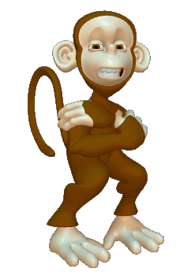
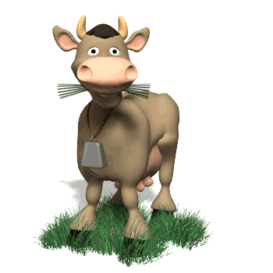
What is meant by characteristics???
For example
Humans are closely related so we can say they have a very close common ancestor.
Humans and chimpanzees are also related but less similar than humans.
So, humans and chimpanzees have a distant common ancestor.
Humans and cow are also related but lesser similar than humans and chimpanzees. So, they have a very distant common ancestor.

Slide 8

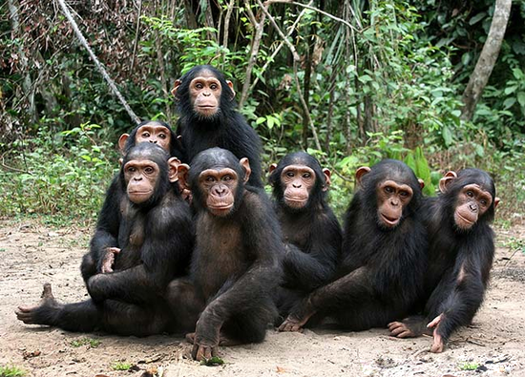
What is meant by characteristics???
So, we can build up small groups of species using recent common ancestor.

Slide 9
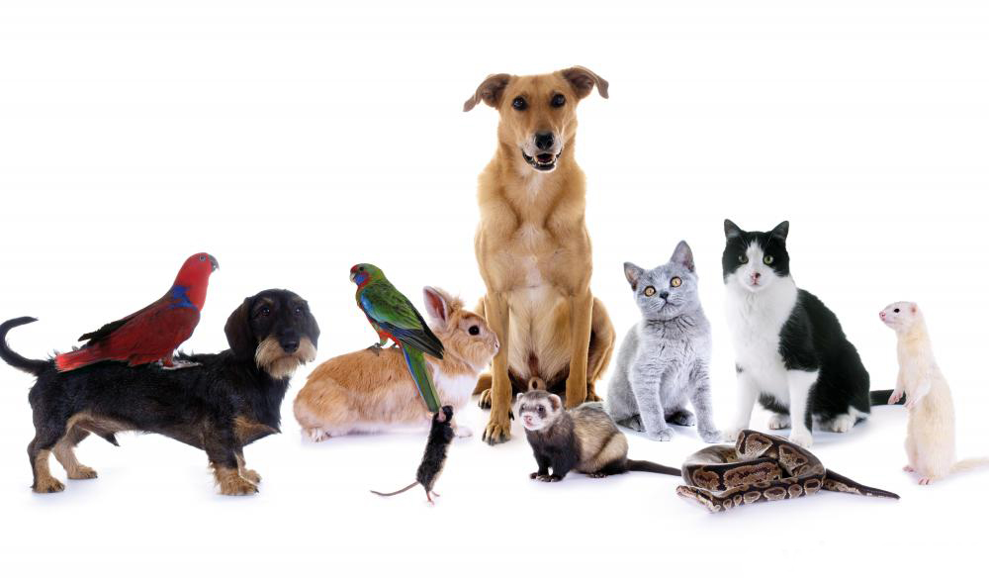
What is meant by characteristics???
Super-groups of these groups with more distant common ancestors.

Slide 10

What is meant by characteristics???
In theory, we can keep going backwards like this until we come to the notion of a single species at the very beginning of evolutionary time.
If that is the case, then at some point in the history of the earth, non-living material must have given rise to life.

Slide 11


There are many theories on evolution of life on earth
But the most accepted theory is…...
Darwin’s Theory of Evolution

Slide 12
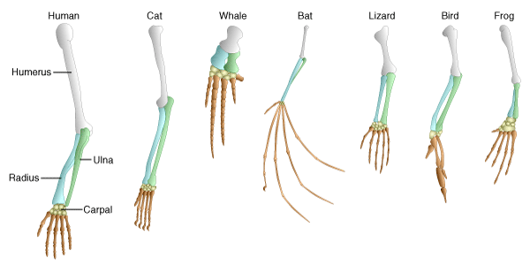
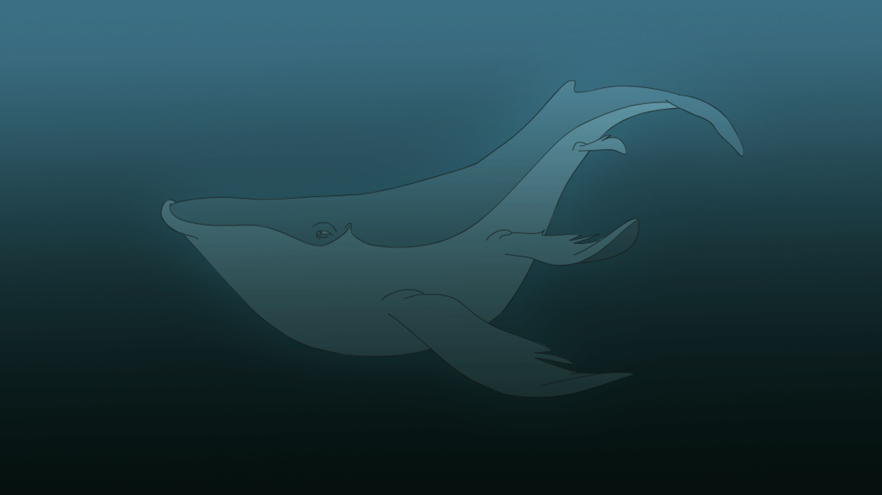
Evidences for Darwin‘s Theory of Evolution
Anatomical Evidences
But they all perform different functions
The basic structure of limbs is similar in mammals, birds, reptiles and amphibians.
Whale use their limbs for swimming

Slide 13
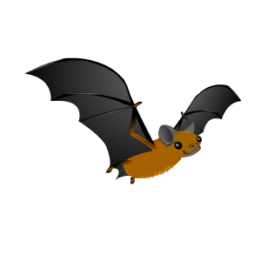

Evidences for Darwin‘s Theory of Evolution
Anatomical Evidences
The basic structure of limbs is similar in mammals, birds, reptiles and amphibians.
Lizards use their limbs for Crawling
Bats use their limbs for Flying

Slide 14
Evidences for Darwin‘s Theory of Evolution
Anatomical Evidences
Such organs which are similar in structure but different in functions are called as homologous organs.
Such homologous characteristics helps to identify an evolutionary relationship between apparently different species.

Slide 15
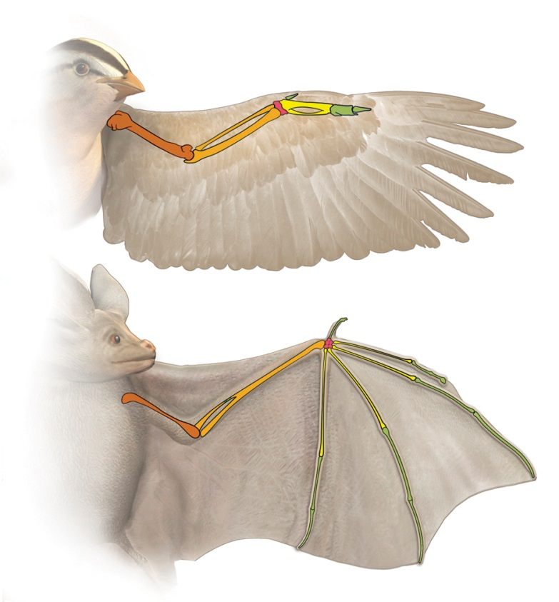
Evidences for Darwin‘s Theory of Evolution
Anatomical Evidences
On contrary, all similarities simply in organ shape are not necessarily because of common ancestry.
For example
Wings of bird and wings of bats.
Wings of bird are a feathery covering all over the arm.
Wings of bat are skin folds stretched mainly between elongated fingers.
Such organs which are similar in function but different in structure are called as analogous organs.
They have different structure but they perform the similar function of flying

Slide 16
Thank You

